Slide 2
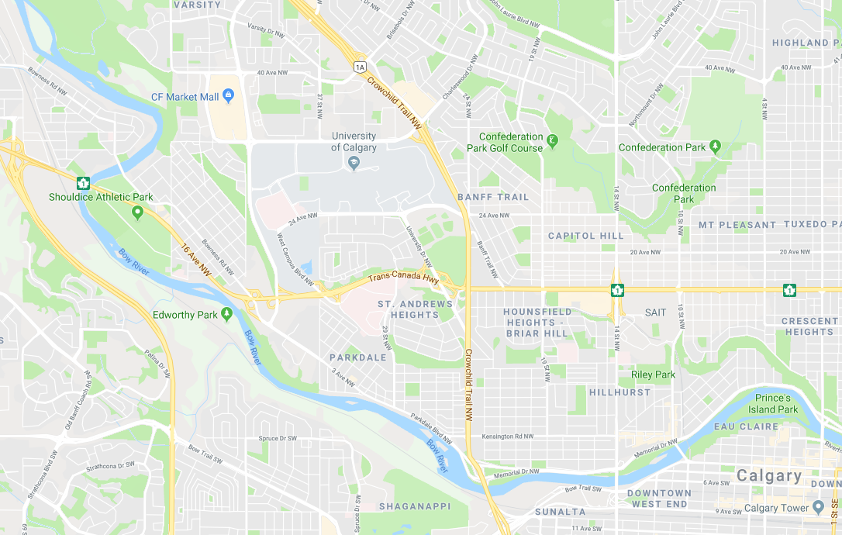









http://iocmanagementsystem.com/view/main_page
R
Robot Co. Maintenance IOC
S
Search for robot/crew name…
Layers
Maintenance Summary:
 |  |  |  |  | otw: | OS:
30 | 5 | 10 | 15 | 5 | 2 | 3 | 10 | 5 | 5
N
Robot
High Priority
Robot_1
Medium Priority
Robot_4
Robot_5
Low Priority
Robot_3
Robot
Name
Maintenance Crew
Robot_2
Crew_1
Crew
Name
Route
Confirmed
Pending
Robot_7
Robot_6
Selected Items
Crew_2
Notes:
Main page

Slide 3
http://iocmanagementsystem.com/view/main_page
R
Robot Co. Maintenance IOC
S
Search for robot/crew name…
Layers
Robot
N
High Priority
Robot_1
Medium Priority
Robot_4
Robot_5
Low Priority
Robot_3
Robot
Name
Maintenance Crew
Robot_2
Crew_1
Crew
Name
Route
Confirmed
Pending
Robot_7
Robot_6
Selected Items
Crew_2
Notes:
Main page

Slide 4
http://iocmanagementsystem.com/view/main_page
R
Robot Co. Maintenance IOC
S
Search for robot/crew name…
Layers
Robot
N
High Priority
Medium Priority
Robot_5
Low Priority
Robot_3
Robot
Name
Maintenance Crew
Crew_1
Crew
Name
Route
Confirmed
Pending
Robot_7
Robot_6
Selected Items
Crew_2
Notes:
Main page – no robot high priority

Slide 5
http://iocmanagementsystem.com/view/main_page
R
Robot Co. Maintenance IOC
S
Search for robot/crew name…
Layers
Robot
N
High Priority
Robot_1
Medium Priority
Robot_4
Low Priority
Robot
Name
Maintenance Crew
Robot_2
Crew_1
Crew
Name
Route
Confirmed
Pending
Robot_7
Robot_6
Selected Items
Crew_2
Notes:
Main page – No robot medium priority

Slide 6
http://iocmanagementsystem.com/view/main_page
R
Robot Co. Maintenance IOC
S
Search for robot/crew name…
Layers
Robot
N
High Priority
Robot_1
Medium Priority
Robot_4
Robot_5
Low Priority
Robot_3
Robot
Name
Maintenance Crew
Robot_2
Crew_1
Crew
Name
Route
Confirmed
Pending
Selected Items
Crew_2
Notes:
Main page – no robot low priority

Slide 7
http://iocmanagementsystem.com/view/main_page
R
Robot Co. Maintenance IOC
S
Search for robot/crew name…
Layers
Robot
N
High Priority
Medium Priority
Low Priority
Robot
Name
Maintenance Crew
Crew_1
Crew
Name
Route
Confirmed
Pending
Selected Items
Crew_2
Notes:
Main page – no robot name

Slide 8
http://iocmanagementsystem.com/view/main_page
R
Robot Co. Maintenance IOC
S
Search for robot/crew name…
Layers
Robot
N
High Priority
Medium Priority
Low Priority
Robot
Name
Maintenance Crew
Crew_1
Crew
Name
Route
Confirmed
Pending
Selected Items
Crew_2
Notes:
Main page – no robot

Slide 9
http://iocmanagementsystem.com/view/main_page
R
Robot Co. Maintenance IOC
S
Search for robot/crew name…
Layers
Robot
N
High Priority
Robot_1
Medium Priority
Robot_4
Robot_5
Low Priority
Robot_3
Robot
Name
Maintenance Crew
Robot_2
Crew
Name
Route
Confirmed
Pending
Robot_7
Robot_6
Selected Items
Notes:
Main page – no maintenance crew name

Slide 10
http://iocmanagementsystem.com/view/main_page
R
Robot Co. Maintenance IOC
S
Search for robot/crew name…
Layers
Robot
N
High Priority
Robot_1
Medium Priority
Robot_4
Robot_5
Low Priority
Robot_3
Robot
Name
Maintenance Crew
Robot_2
Crew
Name
Route
Confirmed
Pending
Robot_7
Robot_6
Selected Items
Notes:
Main page – no maintenance crew

Slide 11
http://iocmanagementsystem.com/view/main_page
R
Robot Co. Maintenance IOC
S
Search for robot/crew name…
Layers
Robot
N
High Priority
Robot_1
Medium Priority
Robot_4
Robot_5
Low Priority
Robot_3
Robot
Name
Maintenance Crew
Robot_2
Crew_1
Crew
Name
Route
Confirmed
Pending
Robot_7
Robot_6
Selected Items
Crew_2
Notes:
Main page – no confirmed route

Slide 12
http://iocmanagementsystem.com/view/main_page
R
Robot Co. Maintenance IOC
S
Search for robot/crew name…
Layers
Robot
N
High Priority
Robot_1
Medium Priority
Robot_4
Robot_5
Low Priority
Robot_3
Robot
Name
Maintenance Crew
Robot_2
Crew_1
Crew
Name
Route
Confirmed
Pending
Robot_7
Robot_6
Selected Items
Crew_2
Notes:
Main page – no pending route

Slide 13
http://iocmanagementsystem.com/view/main_page
R
Robot Co. Maintenance IOC
S
Search for robot/crew name…
Layers
Robot
N
High Priority
Robot_1
Medium Priority
Robot_4
Robot_5
Low Priority
Robot_3
Robot
Name
Maintenance Crew
Robot_2
Crew_1
Crew
Name
Route
Confirmed
Pending
Robot_7
Robot_6
Selected Items
Crew_2
Notes:
Main page – no route

Slide 14
http://iocmanagementsystem.com/view/main_page
R
Robot Co. Maintenance IOC
S
Search for robot/crew name…
Layers
Robot
N
High Priority
Robot_1
Medium Priority
Robot_4
Robot_5
Low Priority
Robot_3
Robot
Name
Maintenance Crew
Robot_2
Crew_1
Crew
Name
Robot_3
Health:
Status: Being Fixed by Crew_1
Queue Position: 0
Issue(s):
increased temperature
Route
Confirmed
Pending
EDIT
Robot_7
Robot_6
Selected Items
Select
Stats
Crew_2
Notes:
Main page – Robot_3 clicked

Slide 15

http://iocmanagementsystem.com/view/main_page
R
Robot Co. Maintenance IOC
S
Search for robot/crew name…
Layers
Robot
N
High Priority
Robot_1
Medium Priority
Robot_4
Robot_5
Low Priority
Robot_3
Robot
Name
Maintenance Crew
Robot_2
Crew_1
Crew
Name
Robot_3
Health:
Status: Being Fixed by Crew_1
Queue Position: 0
Issue(s):
increased temperature
Route
Confirmed
Pending
EDIT
Robot_7
Robot_6
Selected Items
Robot_3
Stats
Unselect
Stats
Crew_2
Notes:
Main page – Robot_3 clicked and selected

Slide 16
http://iocmanagementsystem.com/view/main_page
R
Robot Co. Maintenance IOC
S
Search for robot/crew name…
Layers
Robot
N
High Priority
Robot_1
Medium Priority
Robot_4
Robot_5
Low Priority
Robot_3
Robot
Name
Maintenance Crew
Robot_2
Crew_1
Crew
Name
Route
Confirmed
Pending
Robot_7
Robot_6
Selected Items
Robot_3
Stats
Crew_2
Notes:
Main page – Robot_3 selected

Slide 17
http://iocmanagementsystem.com/view/main_page
R
Robot Co. Maintenance IOC
S
Search for robot/crew name…
Layers
Robot
N
High Priority
Robot_1
Medium Priority
Robot_4
Robot_5
Low Priority
Robot_3
Robot
Name
Maintenance Crew
Robot_2
Crew_1
Robot_4
Health:
Status: Pending Maintenance
Queue Position: 2
Issue(s):
Failed capacitor
Crew
Name
Route
Confirmed
EDIT
Pending
Robot_7
Robot_6
Selected Items
Select
Stats
Robot_3
Stats
Crew_2
Notes:
Main page – Robot_4 clicked

Slide 18
http://iocmanagementsystem.com/view/main_page
R
Robot Co. Maintenance IOC
S
Search for robot/crew name…
Layers
Robot
N
High Priority
Robot_1
Medium Priority
Robot_4
Robot_5
Low Priority
Robot_3
Robot
Name
Maintenance Crew
Robot_2
Crew_1
Robot_4
Health:
Status: Pending Maintenance
Queue Position: 2
Issue(s):
Failed capacitor
Crew
Name
Route
Confirmed
EDIT
Pending
Robot_7
Robot_6
Selected Items
Unselect
Stats
Robot_3
Stats
Robot_4
Stats
Crew_2
COMPARE STATS
Notes:
Main page – Robot_4 clicked and selected

Slide 19
http://iocmanagementsystem.com/view/main_page
R
Robot Co. Maintenance IOC
S
Search for robot/crew name…
Layers
Robot
N
High Priority
Robot_1
Medium Priority
Robot_4
Robot_5
Low Priority
Robot_3
Robot
Name
Maintenance Crew
Robot_2
Crew_1
Crew
Name
Route
Confirmed
Pending
Robot_7
Robot_6
Selected Items
Robot_3
Stats
Robot_4
Stats
Crew_2
COMPARE STATS
Notes:
Main page – Robot_4 and Robot_3 clicked and selected

Slide 20
http://iocmanagementsystem.com/view/main_page
R
Robot Co. Maintenance IOC
S
Search for robot/crew name…
Layers
Robot
N
High Priority
Robot_1
Medium Priority
Robot_4
Robot_5
Low Priority
Robot_3
Robot
Name
Maintenance Crew
Robot_2
Crew_1
Crew
Name
Route
Confirmed
Pending
Robot_7
Robot_6
Selected Items
Robot_4
Stats
Crew_2
Notes:
Main page – Robot_4 clicked and selected
** should continue to robot 4 stats page

Slide 21
http://iocmanagementsystem.com/view/main_page
R
Robot Co. Maintenance IOC
S
Search for robot/crew name…
Layers
Crew_2
N
Contact
Robot
On their way to Robot_2
High Priority
Robot_1
Current Job Details
Medium Priority
Robot_4
Robot_5
Replacing motor id: abc123
Tune up
Low Priority
Robot_3
Robot
Name
Maintenance Crew
Robot_2
Crew_1
Route
Crew
Name
Confirmed:
Pending:
Route
Robot_2 | QP: 1
Confirmed
Stats
Pending
Robot_7
Robot_6
Robot_1 | QP: 3
Robot_8 | QP: 5
Robot_11 | QP: 7
Selected Items
Stats
Stats
Stats
Tools and Supplies
Wrench Set
Thor’s Hammer
Bag of Chips
Tim’s gift card
Crew_2
Notes:
Main page – Crew_2 details

Slide 22
http://iocmanagementsystem.com/view/main_page
R
Robot Co. Maintenance IOC
S
Search for robot/crew name…
Layers
Crew_1
N
Contact
Robot
Fixing Robot_3
High Priority
Robot_1
Current Job Details
Medium Priority
Robot_4
Robot_5
Identifying source of temperature increase
Tune up
Low Priority
Robot_3
Robot
Name
Maintenance Crew
Robot_2
Crew_1
Route
Crew
Name
Confirmed:
None
Pending:
Route
Confirmed
Pending
Robot_7
Robot_6
Robot_4 | QP: 2
Robot_5 | QP: 4
Robot_12 | QP: 8
Selected Items
Stats
Stats
Stats
Tools and Supplies
Screwdrivers
Flat head screws
Laser thermometer
Crew_2
Notes:
Main page – Crew_1 details

Slide 23
http://iocmanagementsystem.com/view/main_page
R
Robot Co. Maintenance IOC
S
Search for robot/crew name…
Layers
Robot
N
High Priority
Robot_1
Medium Priority
Robot_4
Robot_5
Low Priority
Robot_3
Robot
Name
Maintenance Crew
Robot_2
Crew_1
Crew
Name
Robot_5
Health:
Status: Pending Maintenance
Queue Position: 4
Issue(s):
Decreased process rate
Route
Confirmed
EDIT
Pending
Robot_7
Robot_6
Selected Items
Select
Stats
Crew_2
Notes:
Main page – Robot_5 clicked

Slide 24
http://iocmanagementsystem.com/view/main_page
R
Robot Co. Maintenance IOC
S
Search for robot/crew name…
Layers
Robot
N
High Priority
Robot_1
Medium Priority
Robot_4
Robot_5
Low Priority
Robot_3
Robot
Name
Maintenance Crew
Robot_2
Crew_1
Crew
Name
Robot_5
Health:
Status: Pending Maintenance
Queue Position: 4
Issue(s):
Decreased process rate
Route
Confirmed
DONE
Pending
Robot_7
Robot_6
Selected Items
Select
Stats
Crew_2
Notes:
Main page – Robot_5 clicked, edit queue position 4

Slide 25
http://iocmanagementsystem.com/view/main_page
R
Robot Co. Maintenance IOC
S
Search for robot/crew name…
Layers
Robot
N
High Priority
Robot_1
Medium Priority
Robot_4
Robot_5
Low Priority
Robot_3
Robot
Name
Maintenance Crew
Robot_2
Crew_1
Crew
Name
Robot_5
Health:
Status: Pending Maintenance
Queue Position: 3
Issue(s):
Decreased process rate
Route
Confirmed
DONE
Pending
Robot_7
Robot_6
Selected Items
Select
Stats
Crew_2
Notes:
Main page – Robot_5 clicked, edit queue position 3

Slide 26
http://iocmanagementsystem.com/view/main_page
R
Robot Co. Maintenance IOC
S
Search for robot/crew name…
Layers
Robot
N
High Priority
Robot_1
Medium Priority
Robot_4
Robot_5
Low Priority
Robot_3
Robot
Name
Maintenance Crew
Robot_2
Crew_1
Crew
Name
Robot_5
Health:
Status: Pending Maintenance
Queue Position: 2
Issue(s):
Decreased process rate
Route
Confirmed
DONE
Pending
Robot_7
Robot_6
Selected Items
Select
Stats
Crew_2
Notes:
Main page – Robot_5 clicked, edit queue position 2

Slide 27
http://iocmanagementsystem.com/view/main_page
R
Robot Co. Maintenance IOC
S
Search for robot/crew name…
Layers
Robot
N
High Priority
Robot_1
Medium Priority
Robot_4
Robot_5
Low Priority
Robot_3
Robot
Name
Maintenance Crew
Robot_2
Crew_1
Crew
Name
Robot_5
Health:
Status: Pending Maintenance
Queue Position: 2
Issue(s):
Decreased process rate
Route
Confirmed
EDIT
Pending
Robot_7
Robot_6
Selected Items
Select
Stats
Crew_2
Notes:
Main page – robot_5 clicked – queue changed

Slide 28
http://iocmanagementsystem.com/view/main_page
R
Robot Co. Maintenance IOC
S
Search for robot/crew name…
Layers
Robot
N
High Priority
Robot_1
Medium Priority
Robot_4
Robot_5
Low Priority
Robot_3
Robot
Name
Maintenance Crew
Robot_2
Crew_1
Crew
Name
Route
Confirmed
Pending
Robot_7
Robot_6
Selected Items
Crew_2
Notes:
Main page –queue changed

Slide 29
http://iocmanagementsystem.com/view/main_page
R
Robot Co. Maintenance IOC
S
Search for robot/crew name…
Layers
Crew_1
N
Contact
Robot
Fixing Robot_3
High Priority
Robot_1
Current Job Details
Medium Priority
Robot_4
Robot_5
Identifying source of temperature increase
Tune up
Low Priority
Robot_3
Robot
Name
Maintenance Crew
Robot_2
Crew_1
Route
Crew
Name
Confirmed:
None
Pending:
Route
Confirmed
Pending
Robot_7
Robot_6
Robot_5 | QP: 2
Robot_4 | QP: 4
Robot_12 | QP: 8
Selected Items
Stats
Stats
Stats
Tools and Supplies
Screwdrivers
Flat head screws
Laser thermometer
Crew_2
Notes:
Main page – Crew_1 details – post changing queue

Slide 30
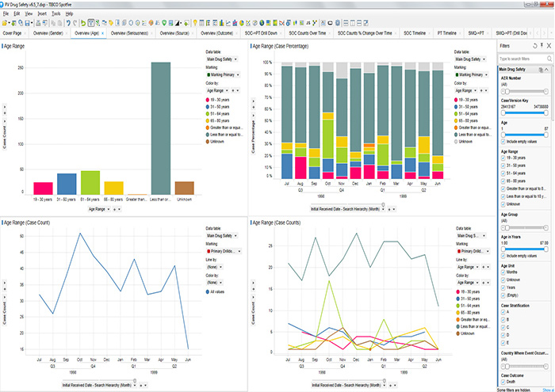
http://iocmanagementsystem.com/view/main_page
R
Robot Co. Maintenance IOC
S
Return to Map
Filters
Robot_1 Stats
Selected Items
Notes:
Main page

Slide 31
http://iocmanagementsystem.com/view/main_page
R
Robot Co. Maintenance IOC
S
Return to Map
Filters
Robot_2 Stats
Selected Items
Notes:
Main page

Slide 32
http://iocmanagementsystem.com/view/main_page
R
Robot Co. Maintenance IOC
S
Return to Map
Filters
Robot_3 Stats
Selected Items
Notes:
Main page

Slide 33
http://iocmanagementsystem.com/view/main_page
R
Robot Co. Maintenance IOC
S
Return to Map
Filters
Robot_4 Stats
Selected Items
Notes:
Main page

Slide 34
http://iocmanagementsystem.com/view/main_page
R
Robot Co. Maintenance IOC
S
Return to Map
Filters
Robot_5 Stats
Selected Items
Notes:
Main page

Slide 35
http://iocmanagementsystem.com/view/main_page
R
Robot Co. Maintenance IOC
S
Return to Map
Filters
Robot_3 Stats
Robot_4 Stats
Selected Items
Robot_3
Stats
Robot_4
Stats
Notes:
Main page

